Slide 1
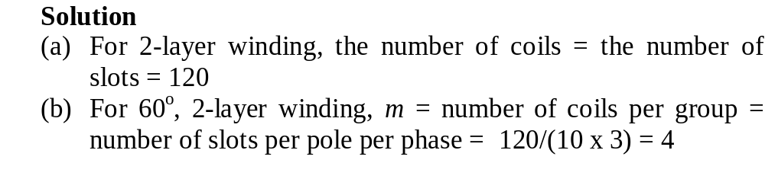
Numerical examples
The stator of a 3-phase, 10-pole induction motor possesses 120 slots. If 60⁰ groups, 2-layer lap winding is used, calculate
The total number of coils
The number of coils per group
Indicate the arrangement and slot numbering of three successive groups of a phase all connected in series. The coils are multi-turn and full-pitch.

Slide 2
Slot span = S/2p = 120/10 = 12.
Therefore y_{b} = slot span x u = 12 x 1 = 12 coil sides.
Thus the return conductor for top layer conductor 1 is 13’, for top layer conductor 2 is 14’, etc.
The top layer are grouped as follows, first 4 conductors to A, next 4 conductors to C’, next 4 conductors to B, next 4 conductors to A’, etc.
The arrangement and slot numbering of three successive coil groups of phase A:
  coil group A starts at 1 and ends at 4,
  coil group A’ starts at 13 and ends at 16 and another
  coil group A starts at 25 and ends at 28
Arrangement shown on the next slide

Slide 3
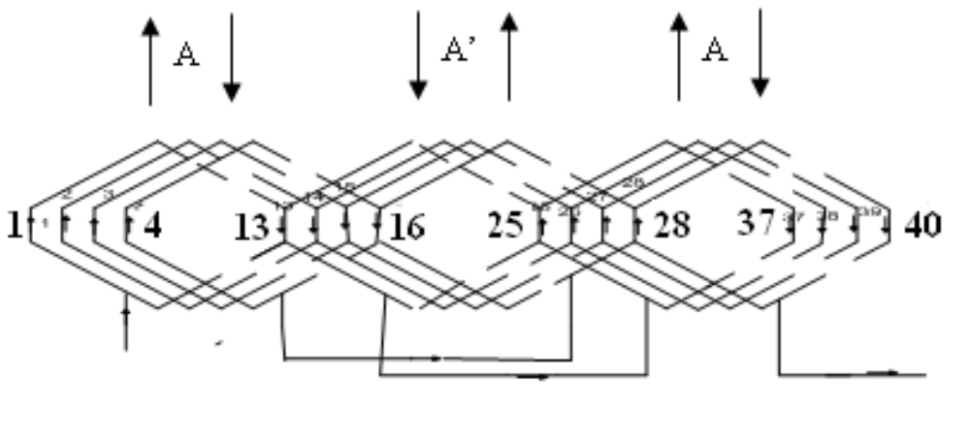
NB: The connection between coils and coils groups should be well indicated.

Slide 4
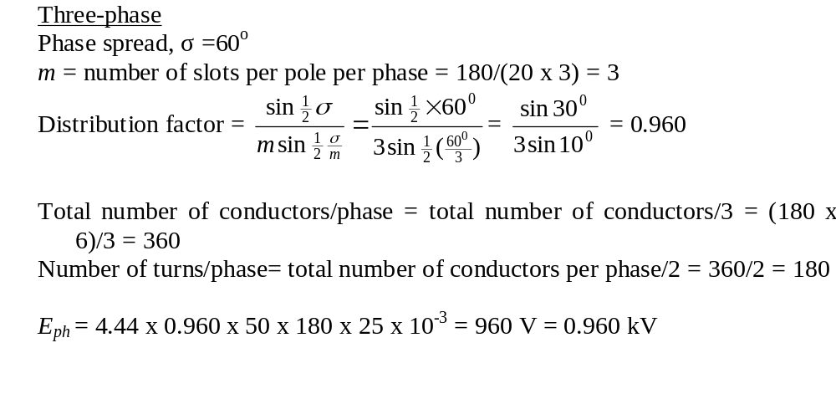
A 20-pole stator has 180 slots with single-layer full pitch coils, 6 conductors per slot, and all coils per phase connected in series. The flux per pole is 25 mWb. Compare the 50-Hz phase emfs in a 1-ph winding with 5 adjacent slots per pole wound (the others being empty), and in a 3-ph star-connected winding with all slots wound.

Slide 5
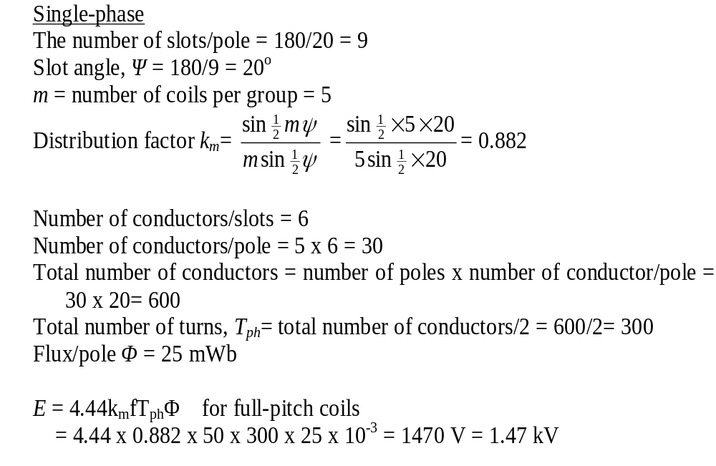

Slide 6
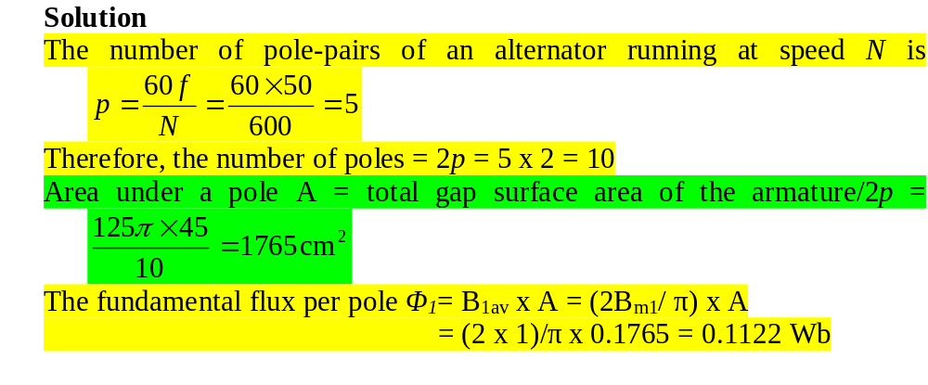
The field form of a 3-phase, 50 Hz, 600-rev/min alternator has spatial flux-density distribution given by the expression: B = sinθ + 0.3sin3θ + 0.2sin5θ tesla. The machine has 180 slots, wound with two-layer 3-turn coils. Each coil spans 15 slots, the coils being connected in 60⁰ groups. The armature diameter is 125 cm and the core length is 45 cm. Calculate (a) the number of poles (b) the rms phase and line voltages.

Slide 7
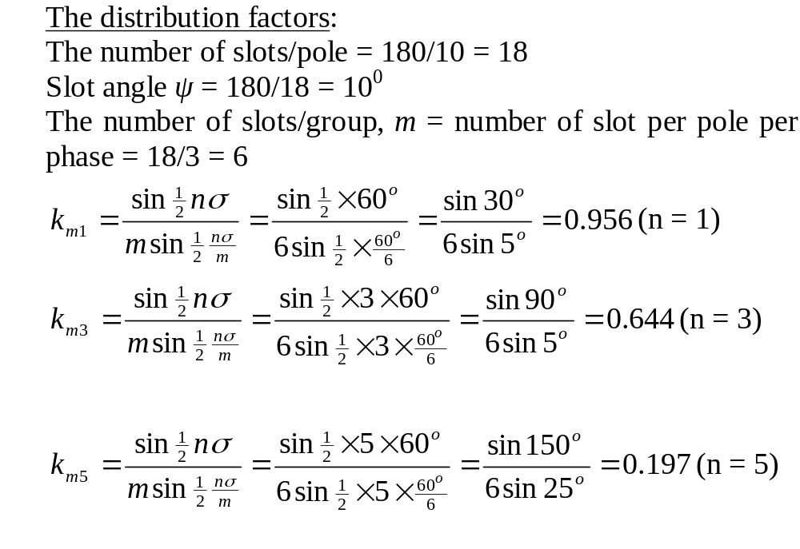

Slide 8
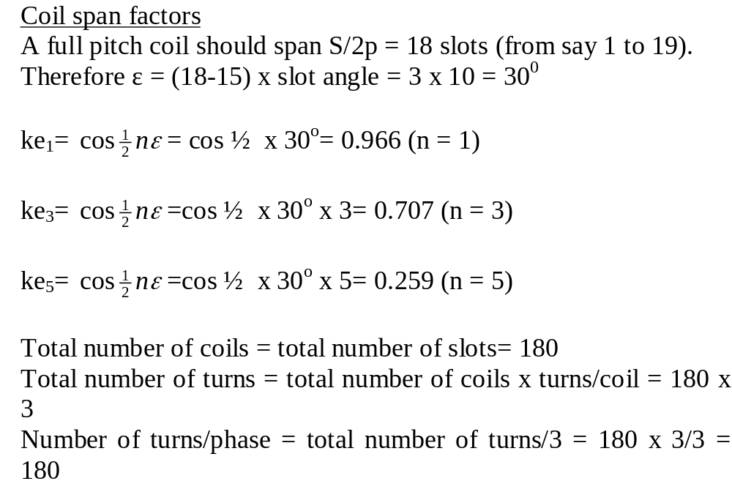

Slide 9
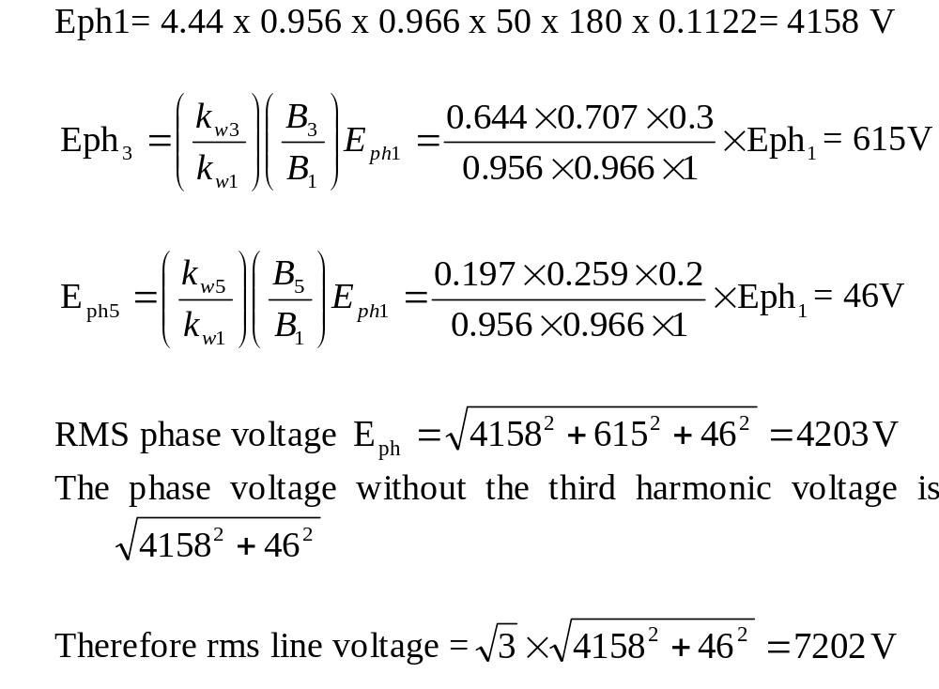

Slide 10
A stator having 24 slots has to be wound with a 3-phase, 4-pole 60⁰ group, 2-layer winding. Determine
(a) the connections between the coils and
(b) the connections between the phases when
(1) star- connected
(2) delta- connected
Solution
For a 4-pole machine, the 24 slots is spread over 4 x 180 electrical degrees.
Therefore the total number of groups = (4 x 180)/ 60 = 12 for 60⁰ coil groups.
Number of groups/phase = 12/3 = 4.
Number of coils in a group= total number of coils /total number of groups= 24/12= 2

Slide 11

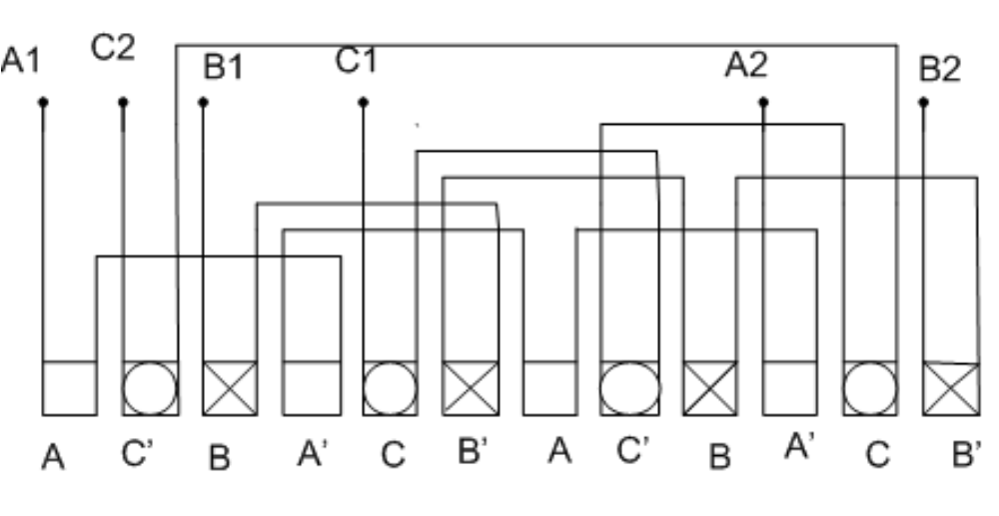

Slide 12
